Slide 1



2024 Single Cell Workship Colombia: Day 1 Nuclei Isolation and Cell Loading
July 12-15, 2024
Bogota, Colombia

Slide 2
Objectives for Today
Nuclei Preparation
Dissociate frozen skin tissue in single nuclei suspension
Count nuclei suspensions via a hemocytometer
Honeycomb CLX
10X Genomics
Load Honeycomb HIVES with live nuclei and cells
Fix nuclei and cells for 10X RNA Fixed Profiling

Slide 3
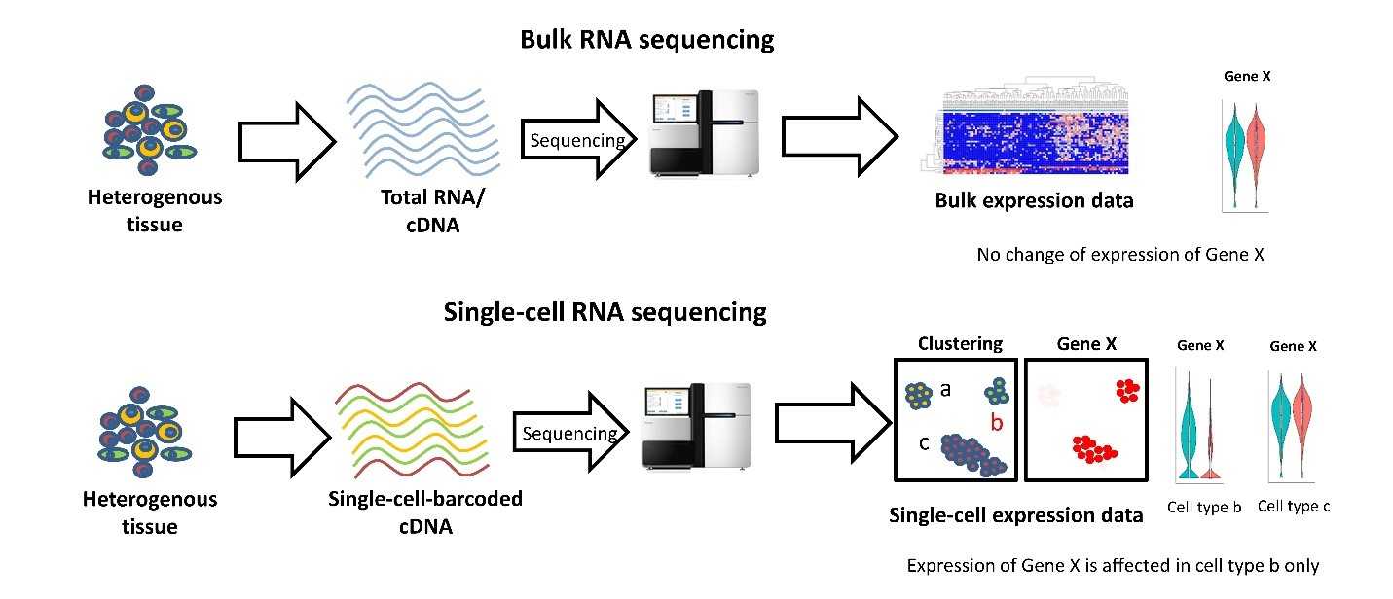
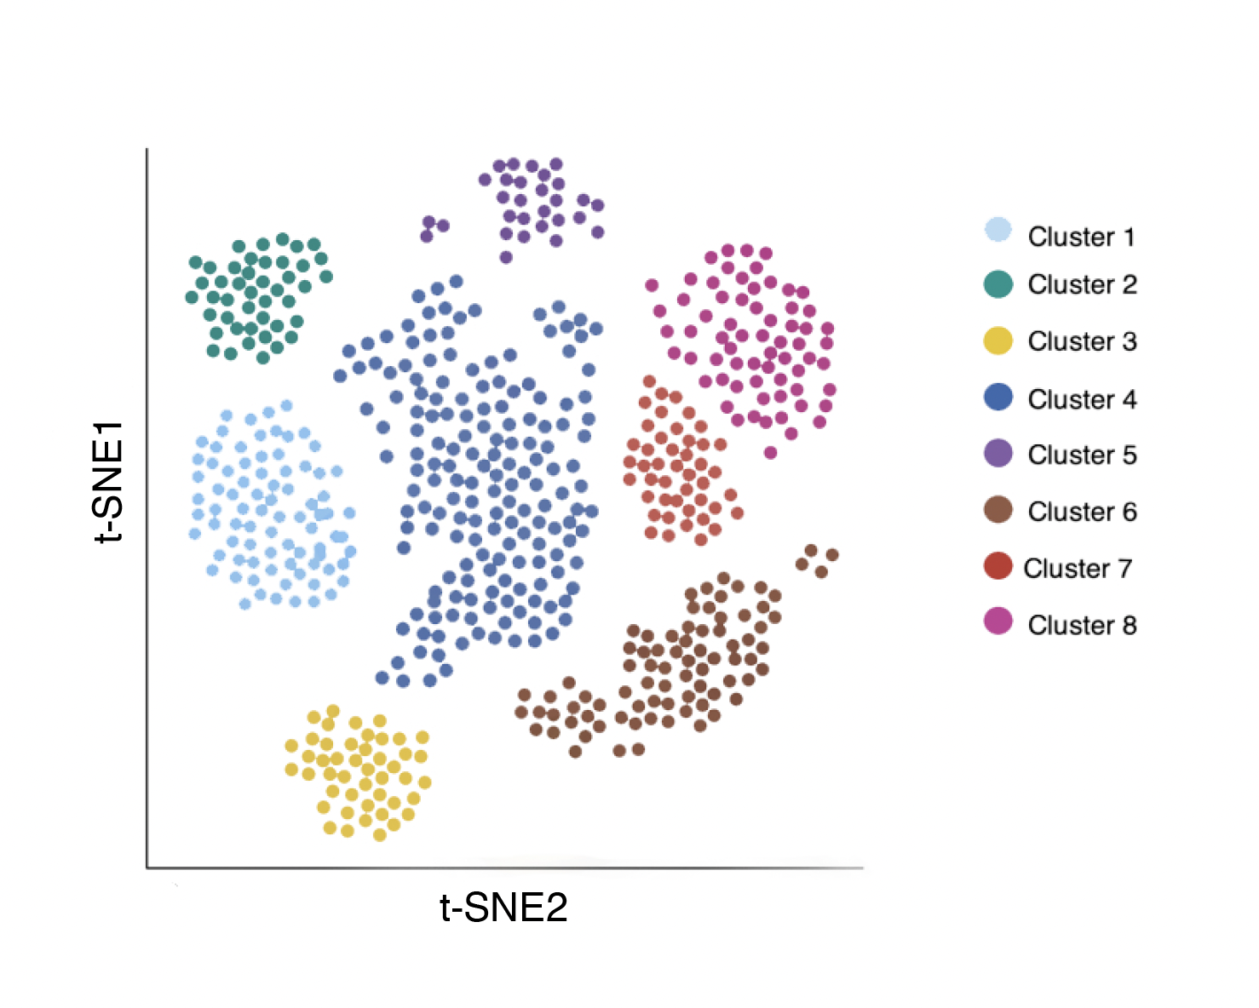
General overview of single-cell RNA workflows
Data Analysis
﻿”Bulk RNA sequencing vs Single-cell RNA sequencing”, Velmeshev (2019)
Notes:
This is the general process for many high-throughput single cell RNA sequencing workflows. Beginning with some heterogeneous sample, we remove DNA, protein, and cellular debris in order to isolate mRNA. The mRNA is reverse transcribed and barcoded resulting in a cDNA library. The prepared library is sequenced, yielding millions of reads(or genes) which need to be mapped to a reference genome. The final result is an expression matrix of cells and genes that can be further analyzed. The main point of difference for many of the high-throughput methods is how the barcoded library is generated.
_______________
Before the emergence of scRNA-seq technology, RNA was profiled using Bulk RNA sequencing, which provides an average expression profile of all the cells in the sample. However, single-cell RNA sequencing can break down the spectrum by enabling the dissection of gene expression at the single cell level.The cDNA product is subsequently amplified by PCR. The amplified whole transcriptome product is barcoded and tagmented to prepare a library for sequencing.

Slide 4
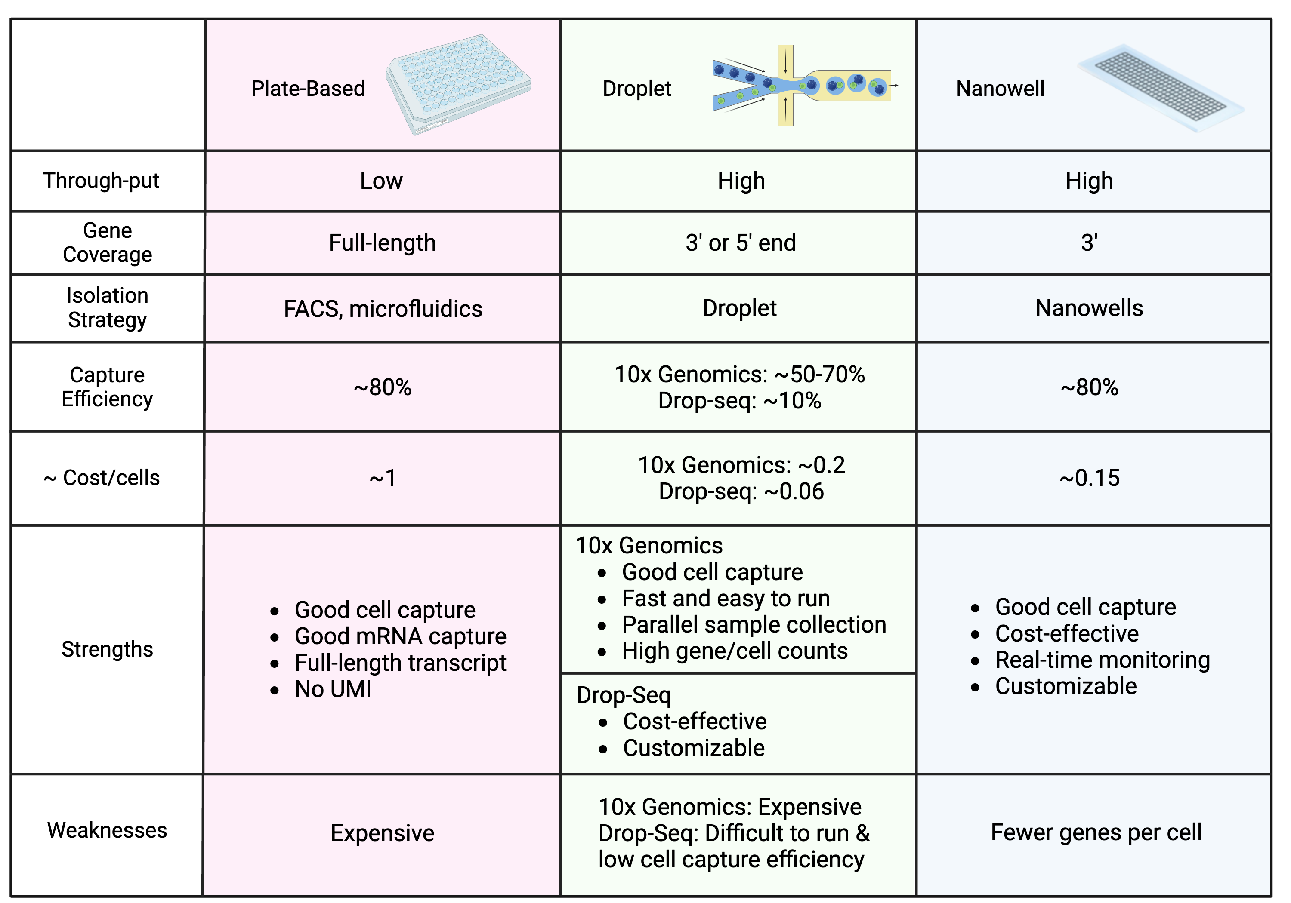
There are many single-cell RNA sequencing methods

Slide 5
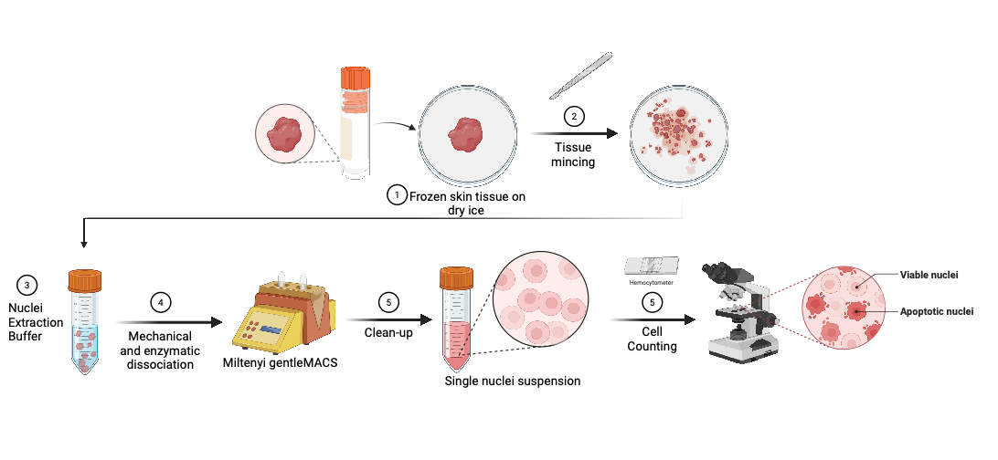
Nuclei Extraction Procedure
Special Considerations
Work fast!
Clean up steps are essential for retaining good quality nuclei
Created with BioRender.com

Slide 6
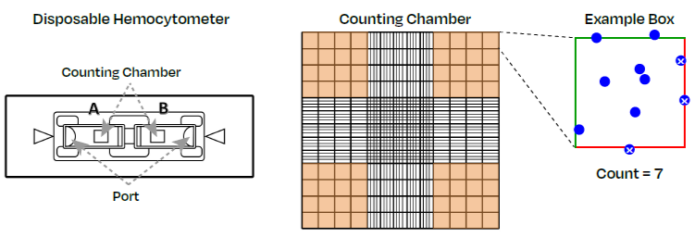
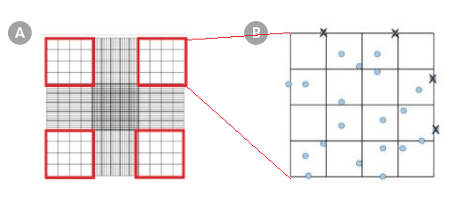
Cell Counting using a Hemocytometer

Slide 7
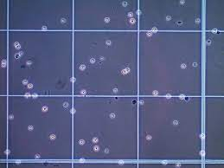
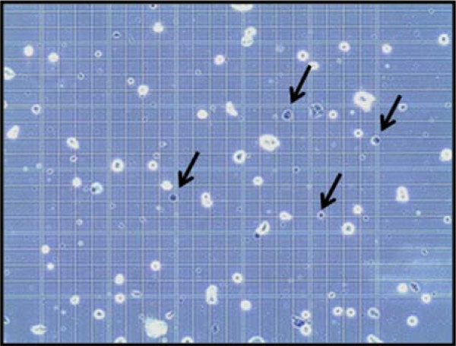
Live vs dead cells on the hemocytometer

Slide 8

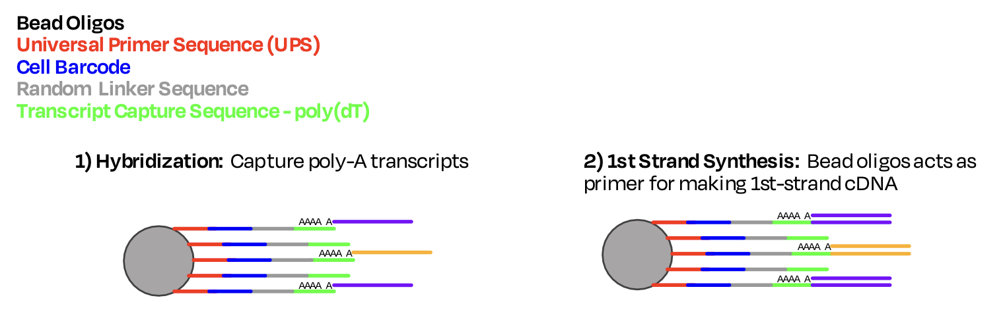
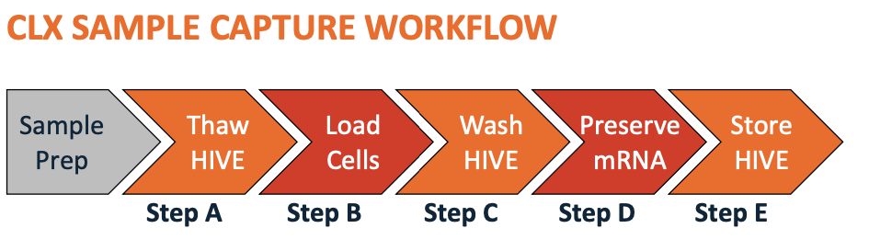
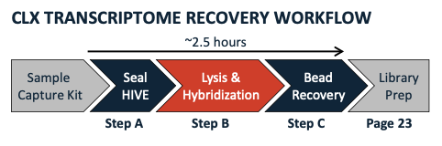
Honeycomb CLX Overview
~ 30 min
Notes:
For honeycomb today, we will be loading the HIVES to capture the poly-A transcripts of our nuclei and cell lines, and then we will go through a series of steps to seal the HIVE membranes, lyse the cells/nuclei, and recover the beads containing the transcripts for first strand synthesis.

Slide 9
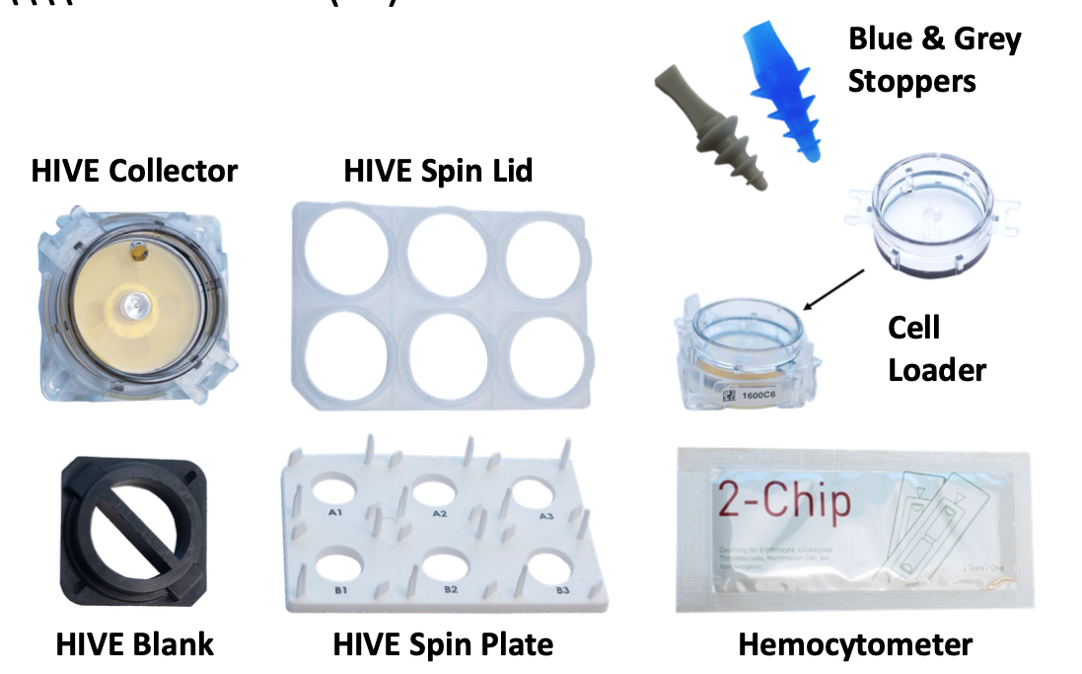
Honeycomb CLX Contents
Notes:
This is the general process for many high-throughput single cell RNA sequencing workflows. Beginning with some heterogeneous sample, we remove DNA, protein, and cellular debris in order to isolate mRNA. The mRNA is reverse transcribed and barcoded resulting in a cDNA library. The prepared library is sequenced, yielding millions of reads(or genes) which need to be mapped to a reference genome. The final result is an expression matrix of cells and genes that can be further analyzed. The main point of difference for many of the high-throughput methods is how the barcoded library is generated.
_______________
Before the emergence of scRNA-seq technology, RNA was profiled using Bulk RNA sequencing, which provides an average expression profile of all the cells in the sample. However, single-cell RNA sequencing can break down the spectrum by enabling the dissection of gene expression at the single cell level.The cDNA product is subsequently amplified by PCR. The amplified whole transcriptome product is barcoded and tagmented to prepare a library for sequencing.

Slide 10
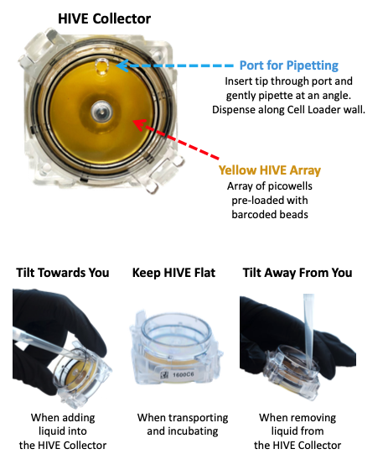
Honeycomb CLX Cell Loading
Notes:
This is the general process for many high-throughput single cell RNA sequencing workflows. Beginning with some heterogeneous sample, we remove DNA, protein, and cellular debris in order to isolate mRNA. The mRNA is reverse transcribed and barcoded resulting in a cDNA library. The prepared library is sequenced, yielding millions of reads(or genes) which need to be mapped to a reference genome. The final result is an expression matrix of cells and genes that can be further analyzed. The main point of difference for many of the high-throughput methods is how the barcoded library is generated.
_______________
Before the emergence of scRNA-seq technology, RNA was profiled using Bulk RNA sequencing, which provides an average expression profile of all the cells in the sample. However, single-cell RNA sequencing can break down the spectrum by enabling the dissection of gene expression at the single cell level.The cDNA product is subsequently amplified by PCR. The amplified whole transcriptome product is barcoded and tagmented to prepare a library for sequencing.

Slide 11
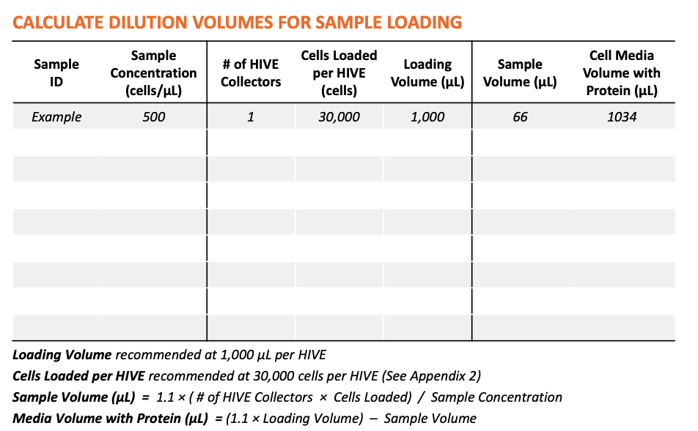
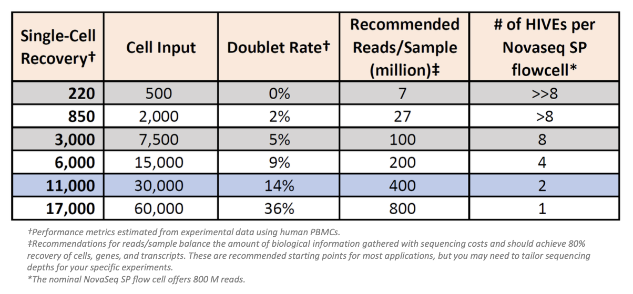
Honeycomb CLX Cell Loading
Notes:
For each sample we will be calculating the concentration and loading 30,000 cells per hive to achieve the optimal recovery of 11,000 cells. In order to do this, we have to calculate how much of our sample we need to take to obtain 30,000 cells and fill the rest with in this case 0.04% BSA + PBS.

Slide 12

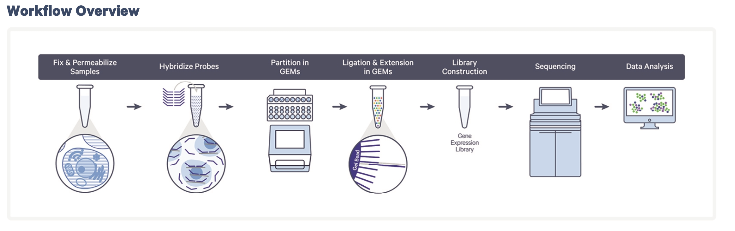
10X Chromium Fixed RNA Profiling –Overview
Day 1
Day 2
Day 3 & 4
Notes:
For this workflow, fixed samples are first hybridized with Probe Barcodes. Then using a microfluidic chip, the hybridized samples are then partitioned into nanoliter-scale Gel Beads-in-emulsion (GEMs). A pool of ~737,000 10x GEM Barcodes (also referred to as 10x Barcodes) is sampled separately to index the
contents of each partition.
Inside the GEMs, probes are ligated and the 10x GEM Barcode is added, and all ligated probes within a GEM share a common 10x GEM Barcode. Barcoded and ligated probes are then pre-amplified in bulk, after which gene expression libraries are generated and sequenced.
Let’s go into a bit more detail as to what is happening in each step, starting with the hybridized probes.

Slide 13
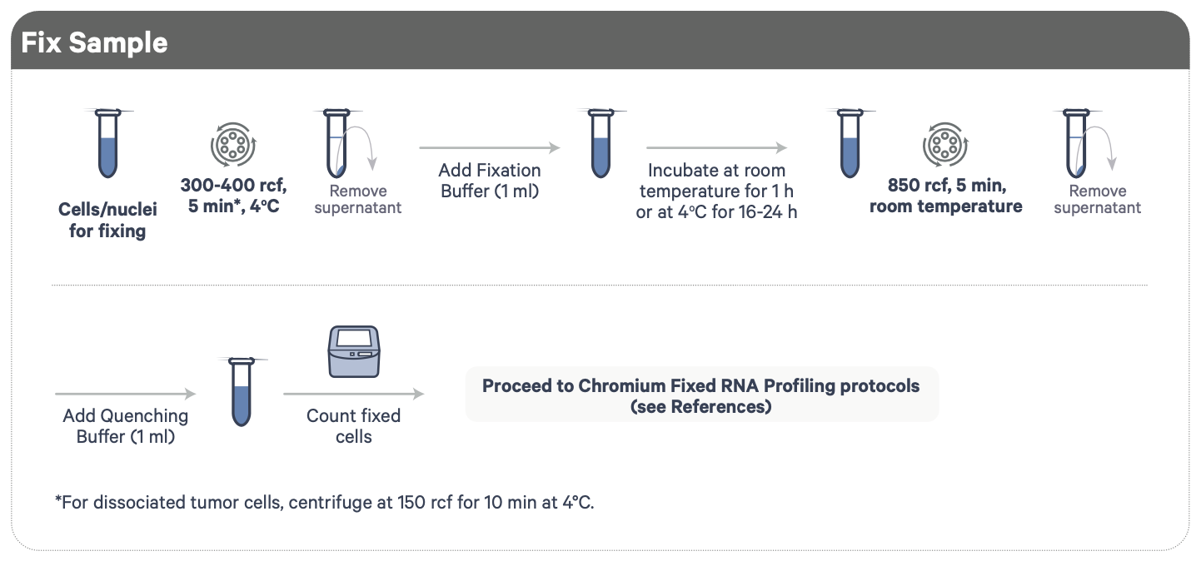
10X Fixing Cells and Nuclei
Contains formaldehyde!
Post nuclei isolation
Demonstrated Protocol | Fixation of Cells & Nuclei for Chromium Fixed RNA Profiling
Notes:
We’ll be taking advantage of a fixation protocol for processing our cells and nuclei. We spin down our cells/nuclei and treat them with a fixation buffer, which contains a mild detergent to help permeabilize the sample as well as formaldehyde which involves in cross-linking of proteins to preserve the biological state of our samples and prevent degradation.
IMPORTANT: Formaldehyde must be used under a fume hood with proper ventilation!
After fixation, we spin down again and replace with quenching buffer to inactivate the fixation as prolong fixation can very much affect sample quality.

Slide 14
10X Fixing Cells and Nuclei
Day 1
Day 2
Post nuclei isolation
Demonstrated Protocol | Fixation of Cells & Nuclei for Chromium Fixed RNA Profiling
Notes:
We’ll be taking advantage of a fixation protocol for processing our cells and nuclei. We spin down our cells/nuclei and treat them with a fixation buffer, which contains a mild detergent to help permeabilize the sample as well as formaldehyde which involves in cross-linking of proteins to preserve the biological state of our samples and prevent degradation.
IMPORTANT: Formaldehyde must be used under a fume hood with proper ventilation!
After fixation, we spin down again and replace with quenching buffer to inactivate the fixation as prolong fixation can very much affect sample quality.

